Slide 1
Time Series Forecasting Final Project Homework6
By
Jaswanth Das Gunturu
Aditya Gidda

Slide 2
Data Set
https://finance.yahoo.com/quote/AXP?p=AXP
The data is the American Express Stock Data.
Dated from 2008 to 2018 monthly data.

Slide 3
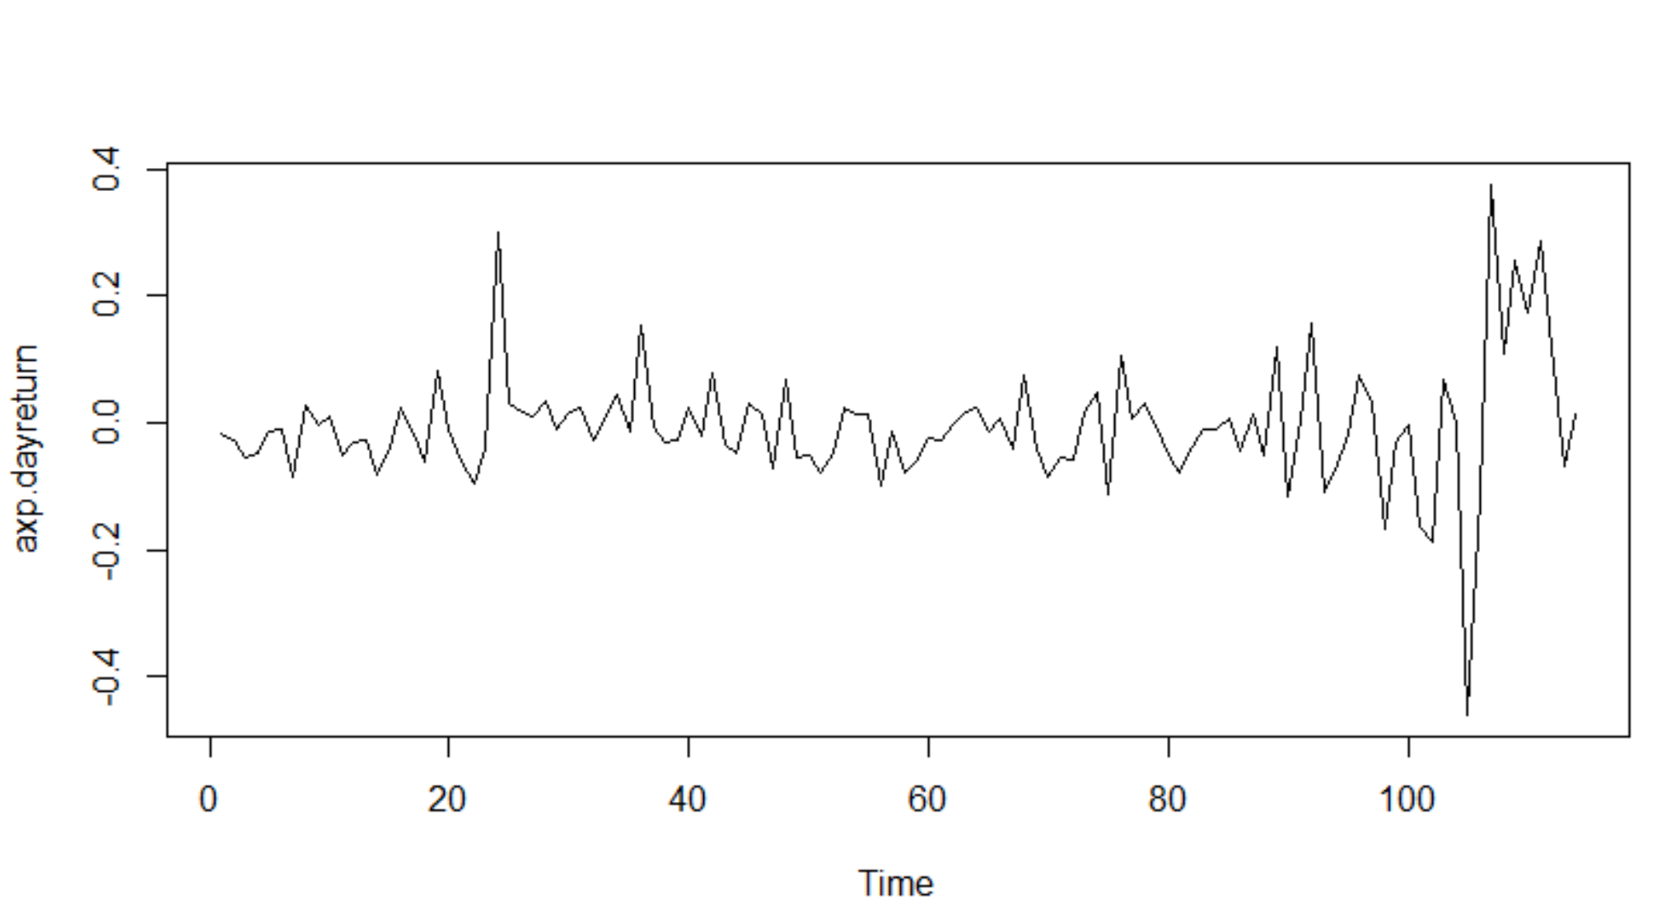
EDA Time Series Plot for the dayreturn

Slide 4
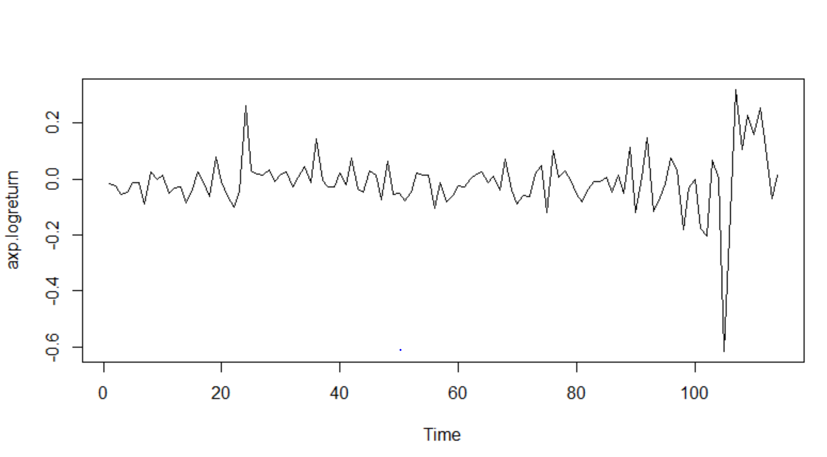
EDA
Time Series Plot for the logreturn

Slide 5
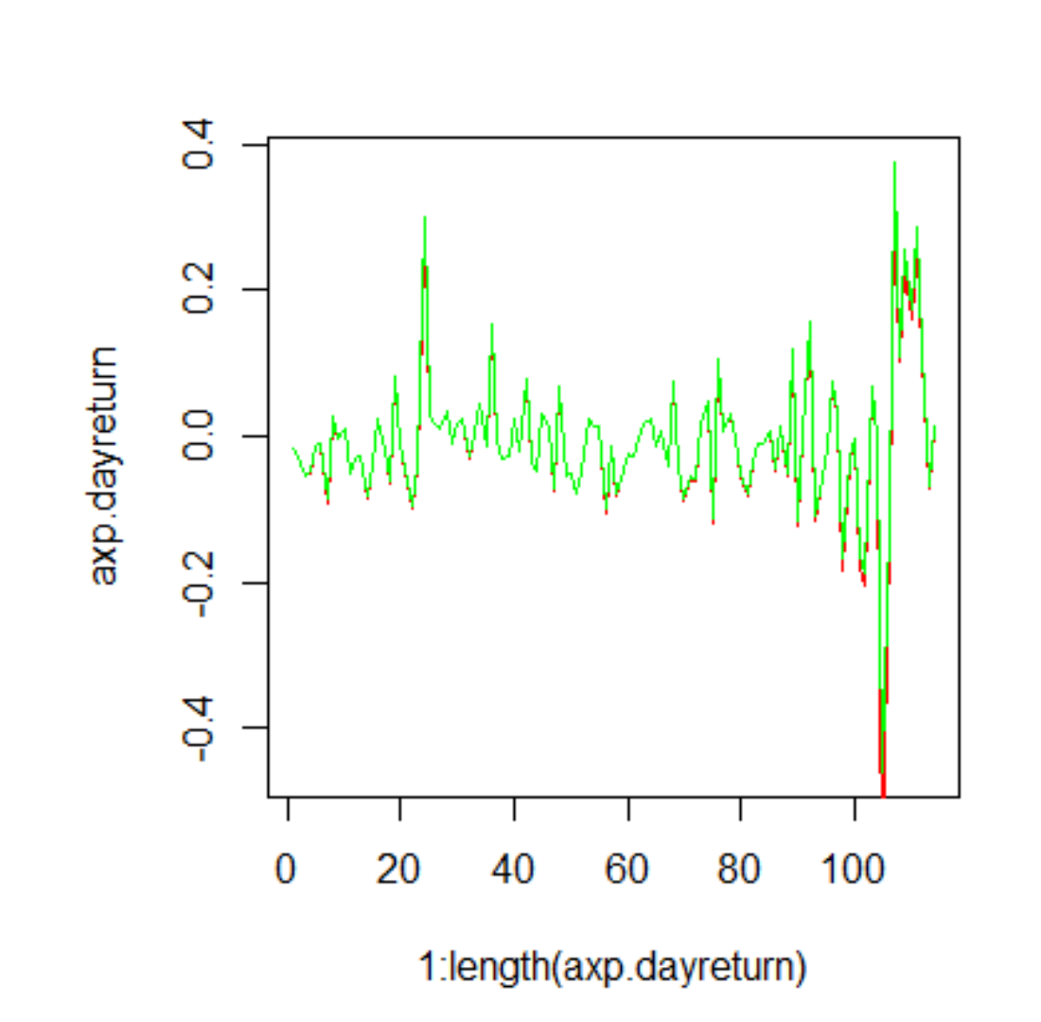
Time series plot of dayreturn and log return

Slide 6
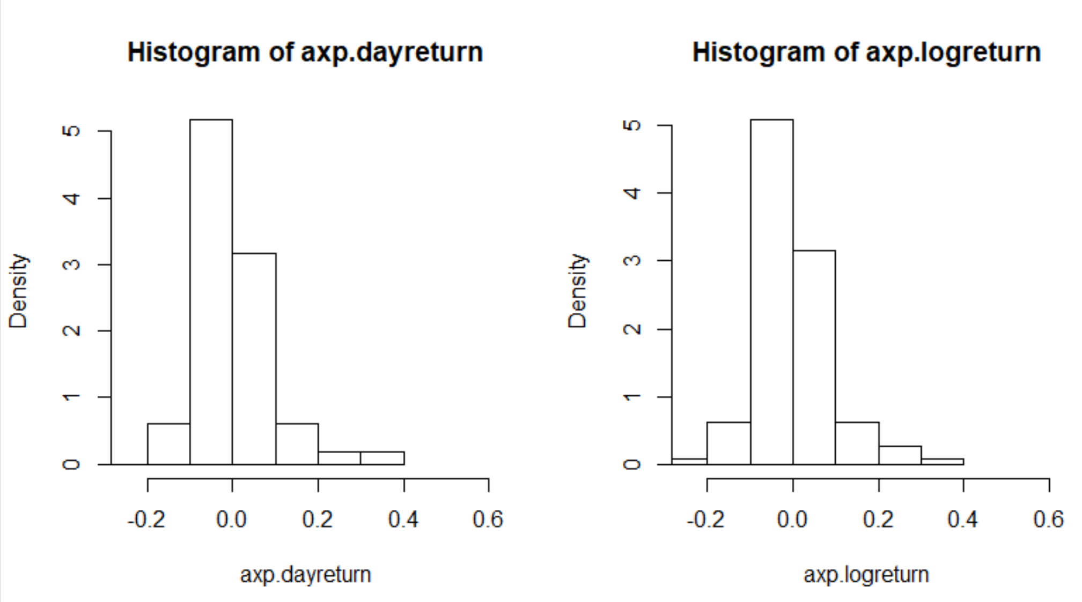
EDA

Slide 7
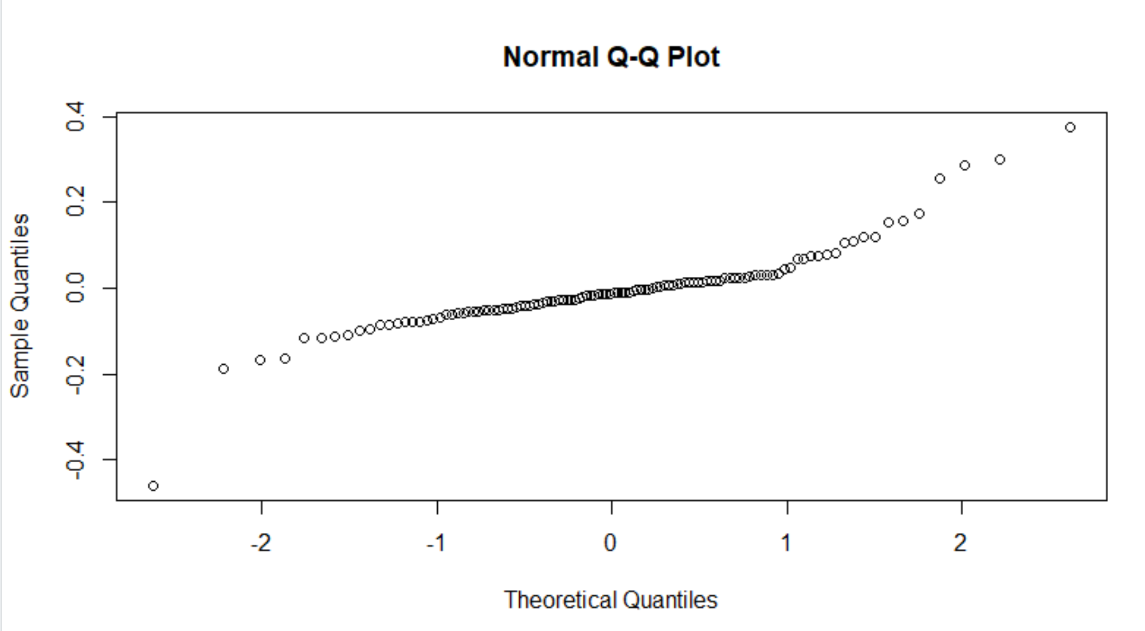
EDA

Slide 8
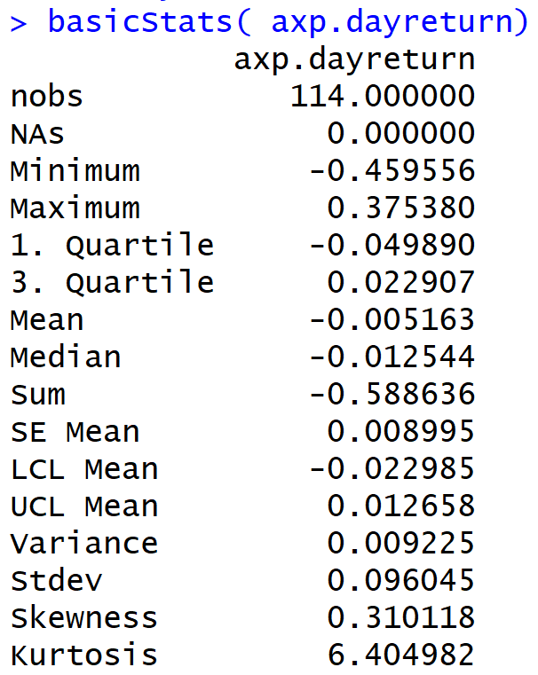
EDA

Slide 9
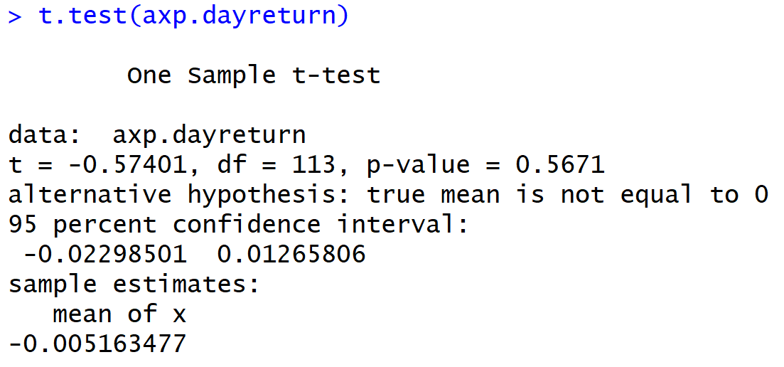
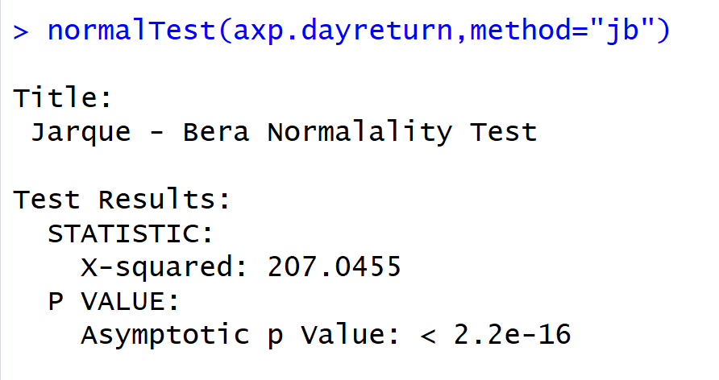
Tests

Slide 10
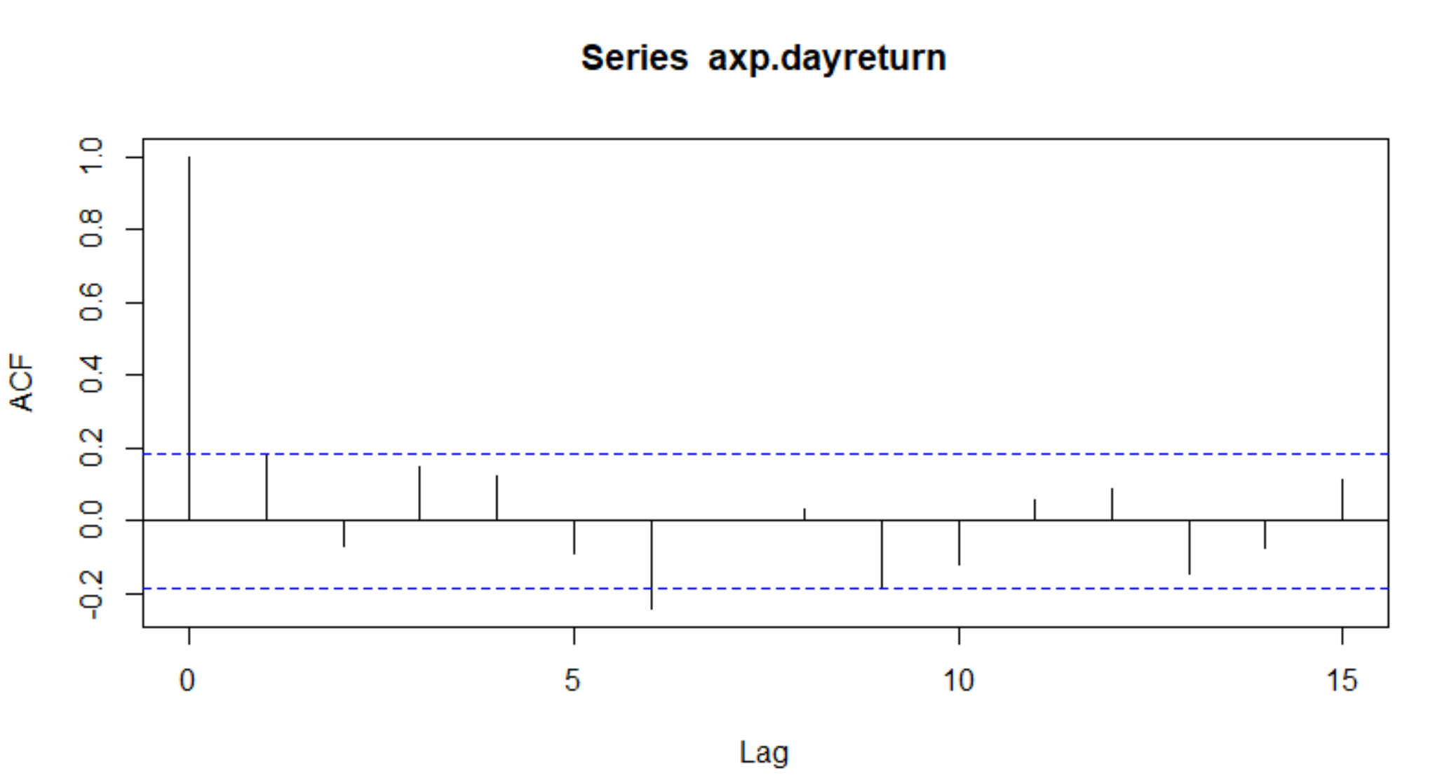
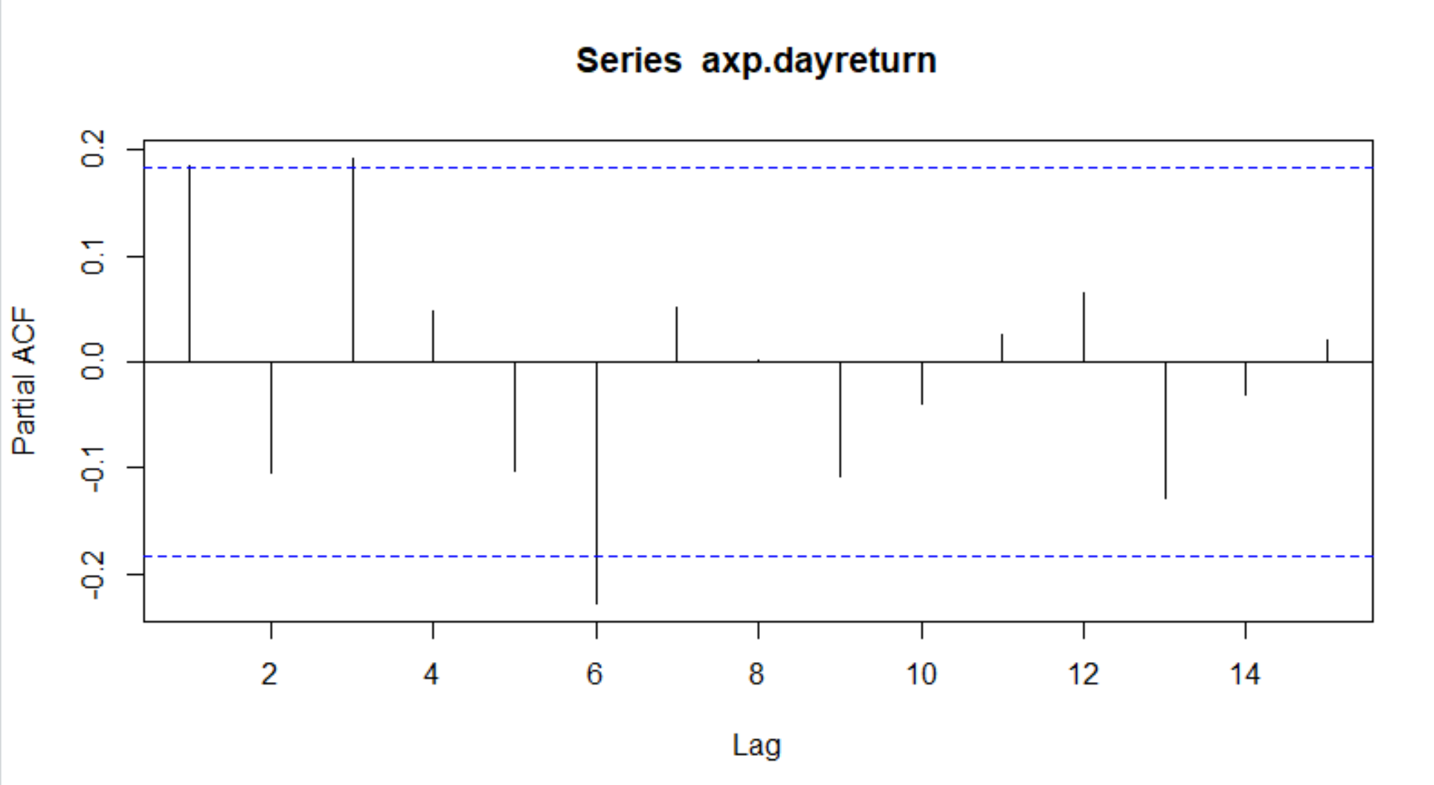
EDA
ACF and PACF

Slide 11
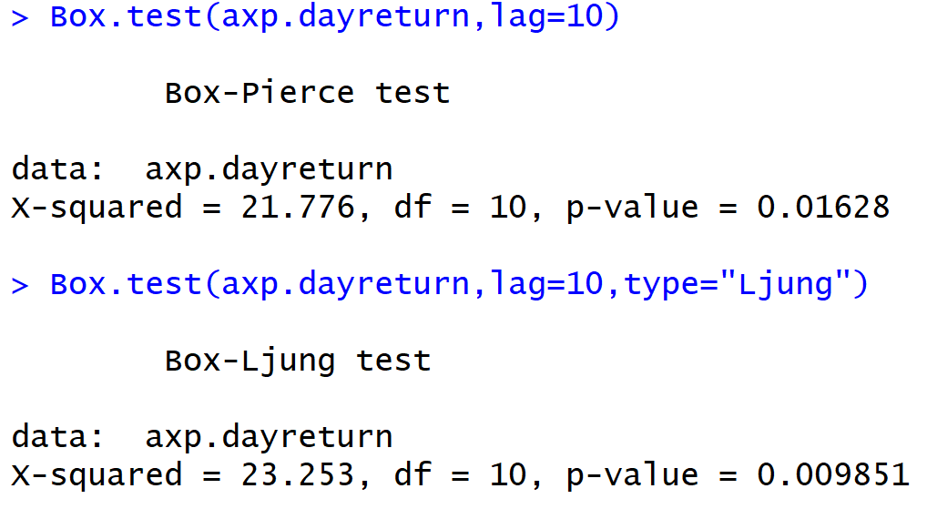
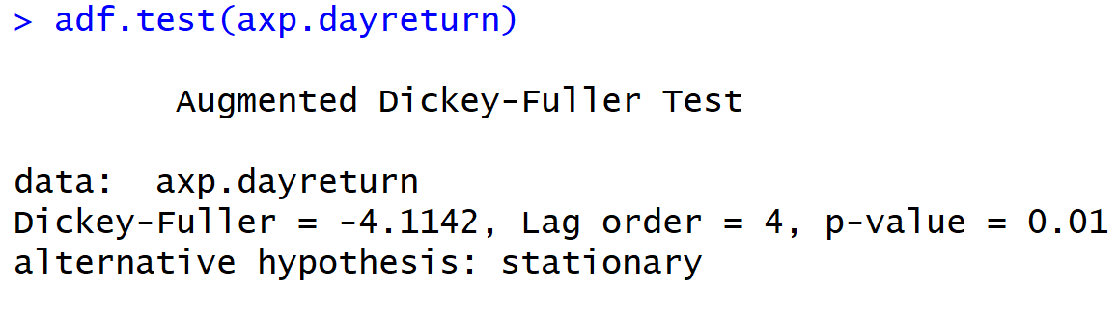
EDA
Box tests and ADF test

Slide 12
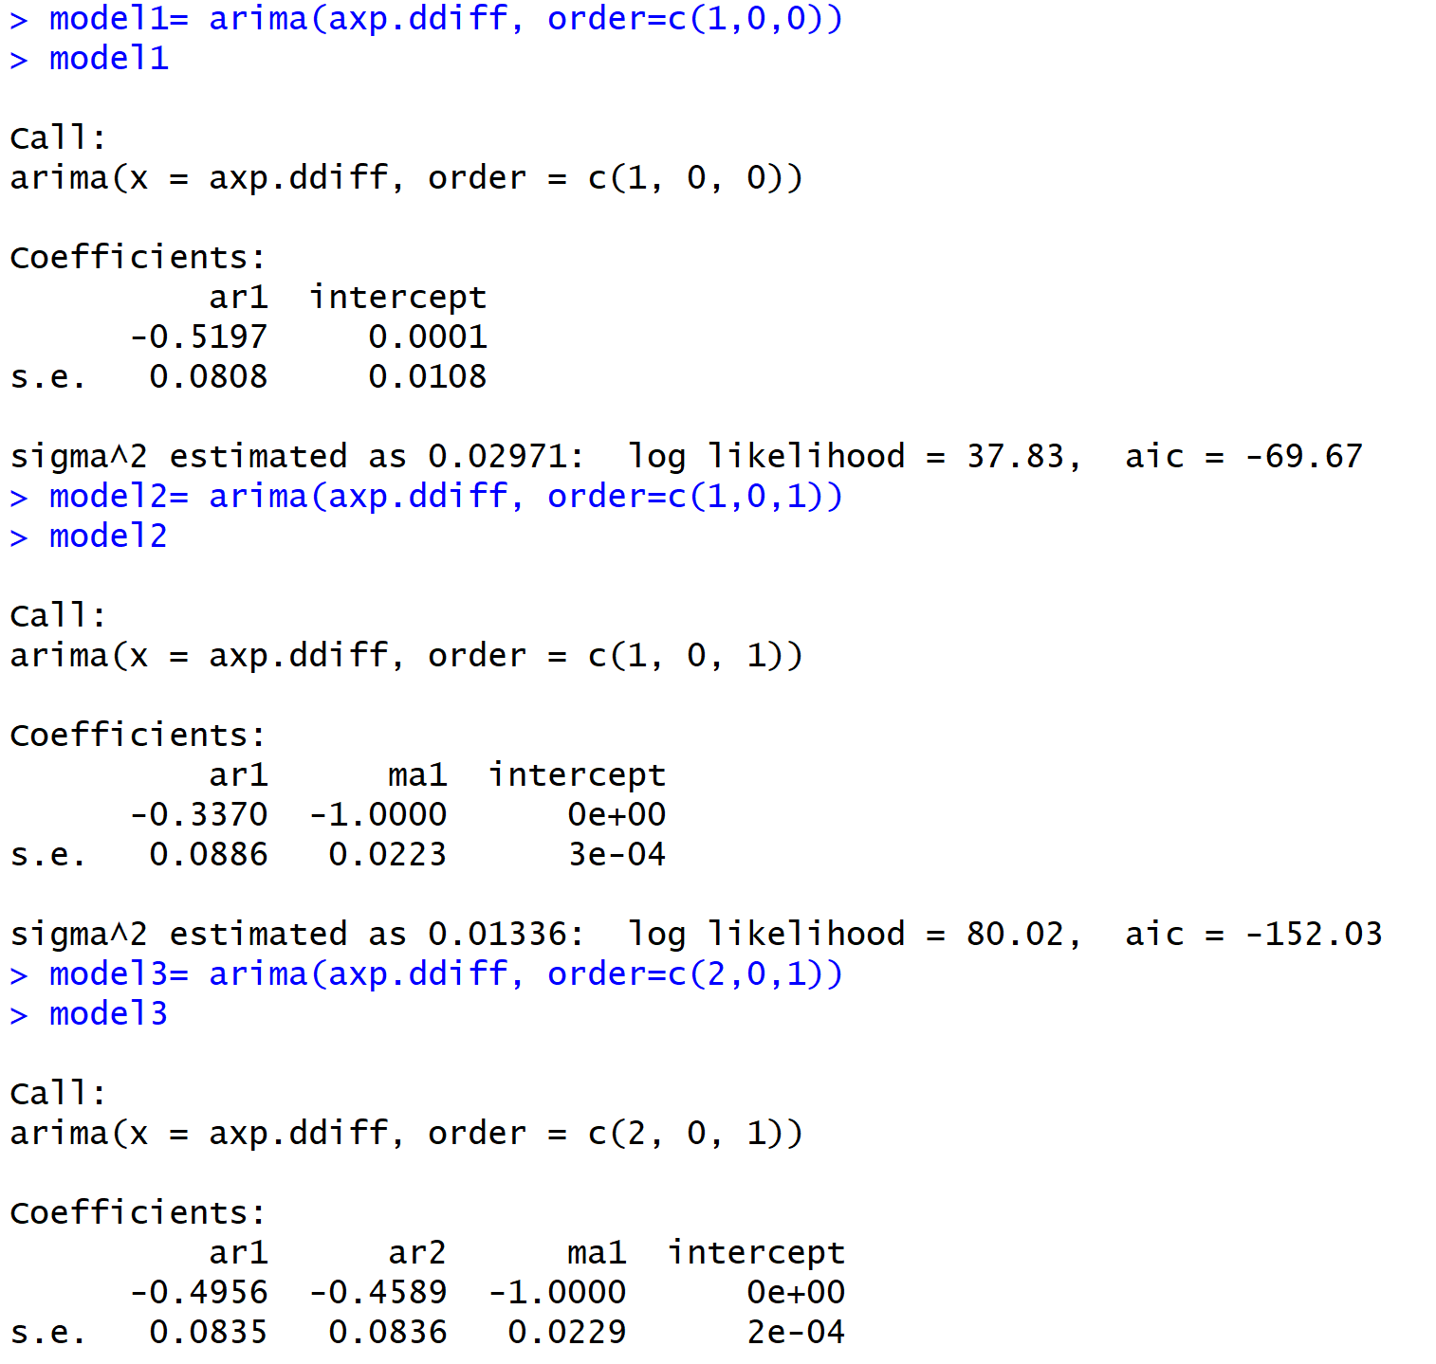
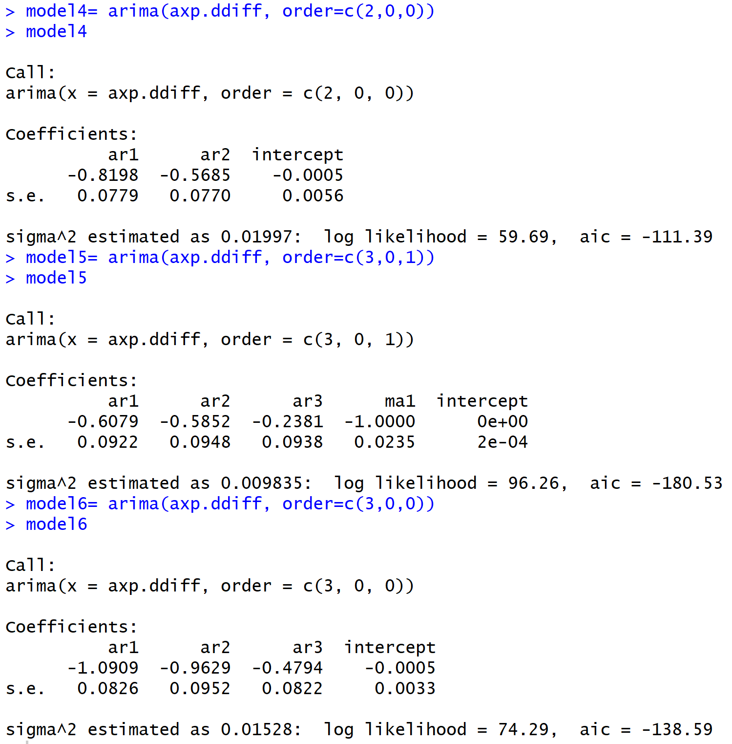
Building the Model

Slide 13
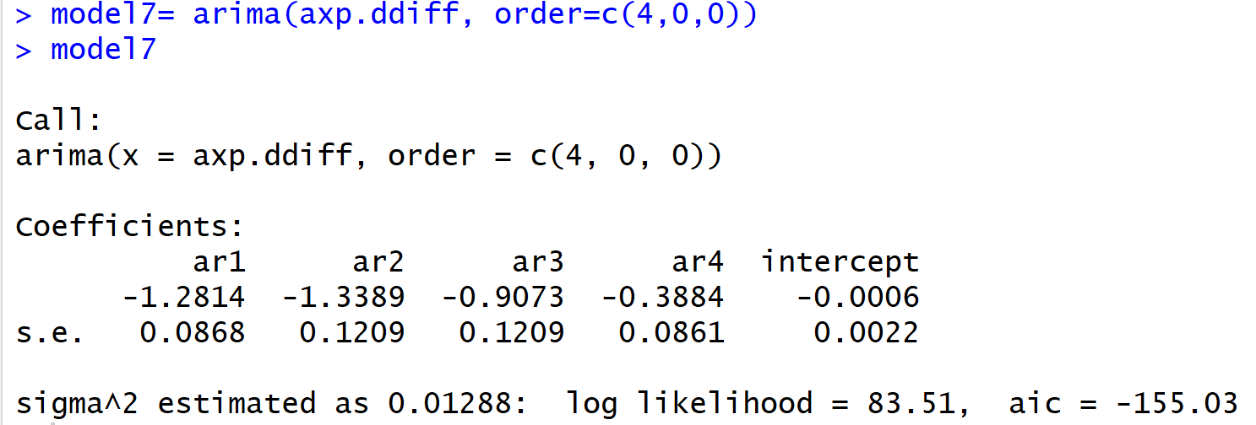
Best Model

Slide 14
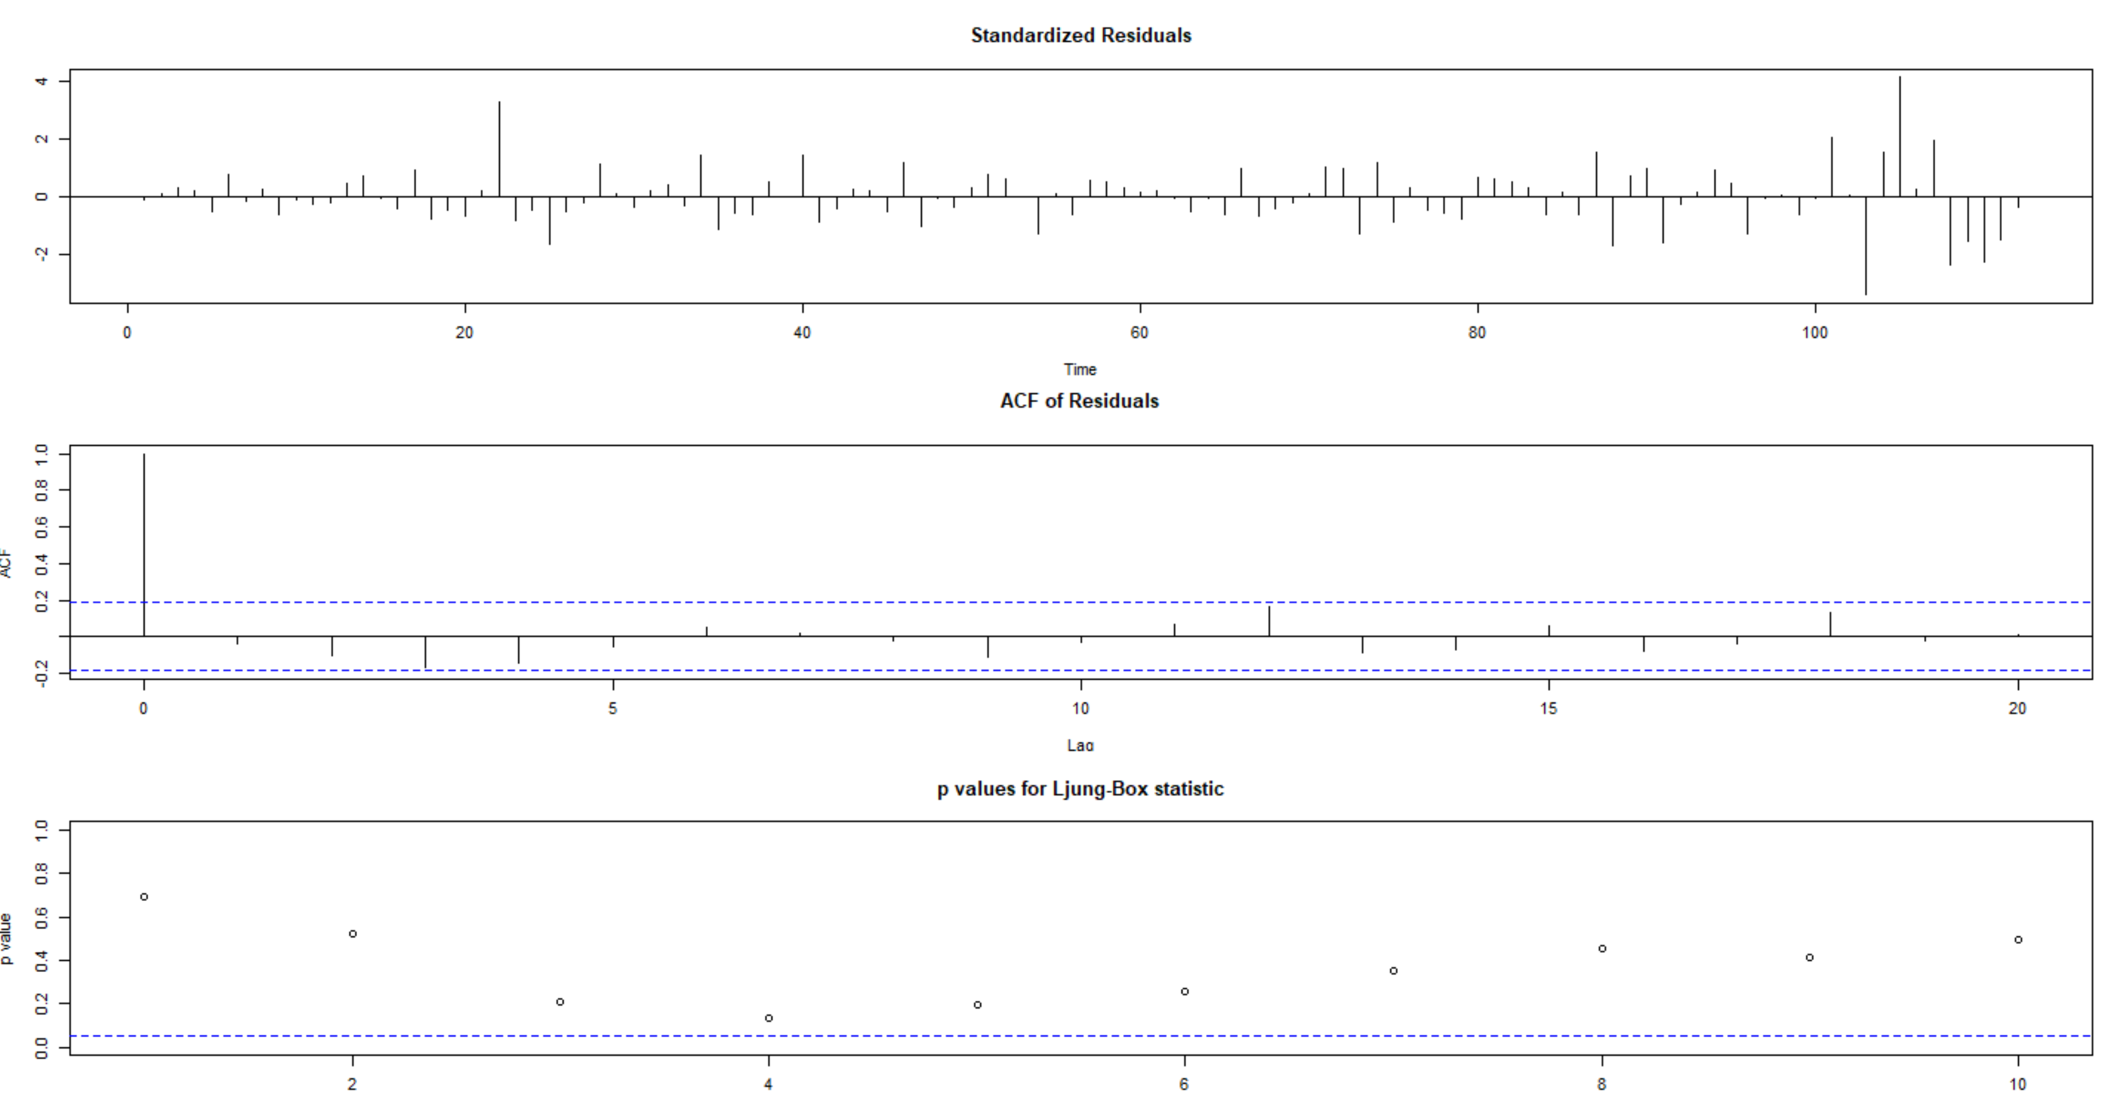

Slide 15
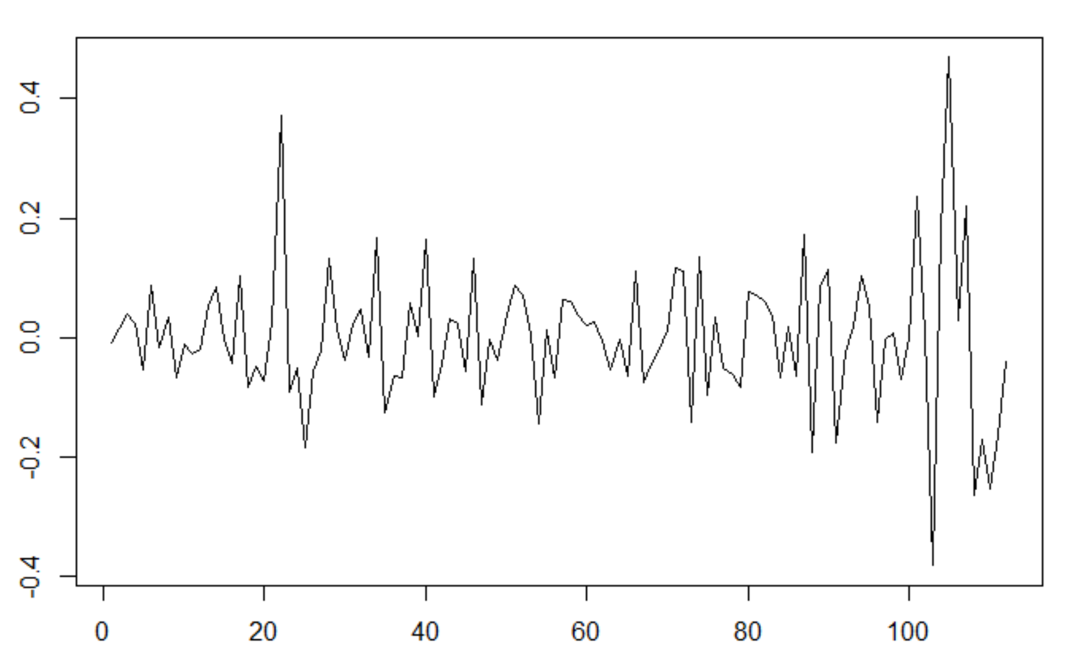
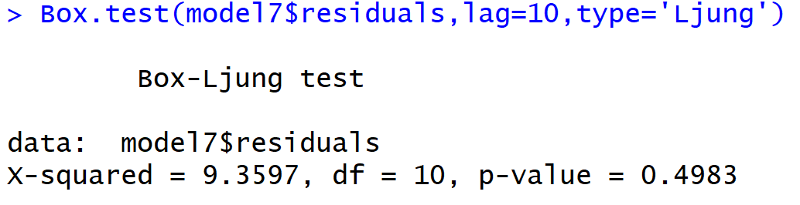
Residual Plot

Slide 16
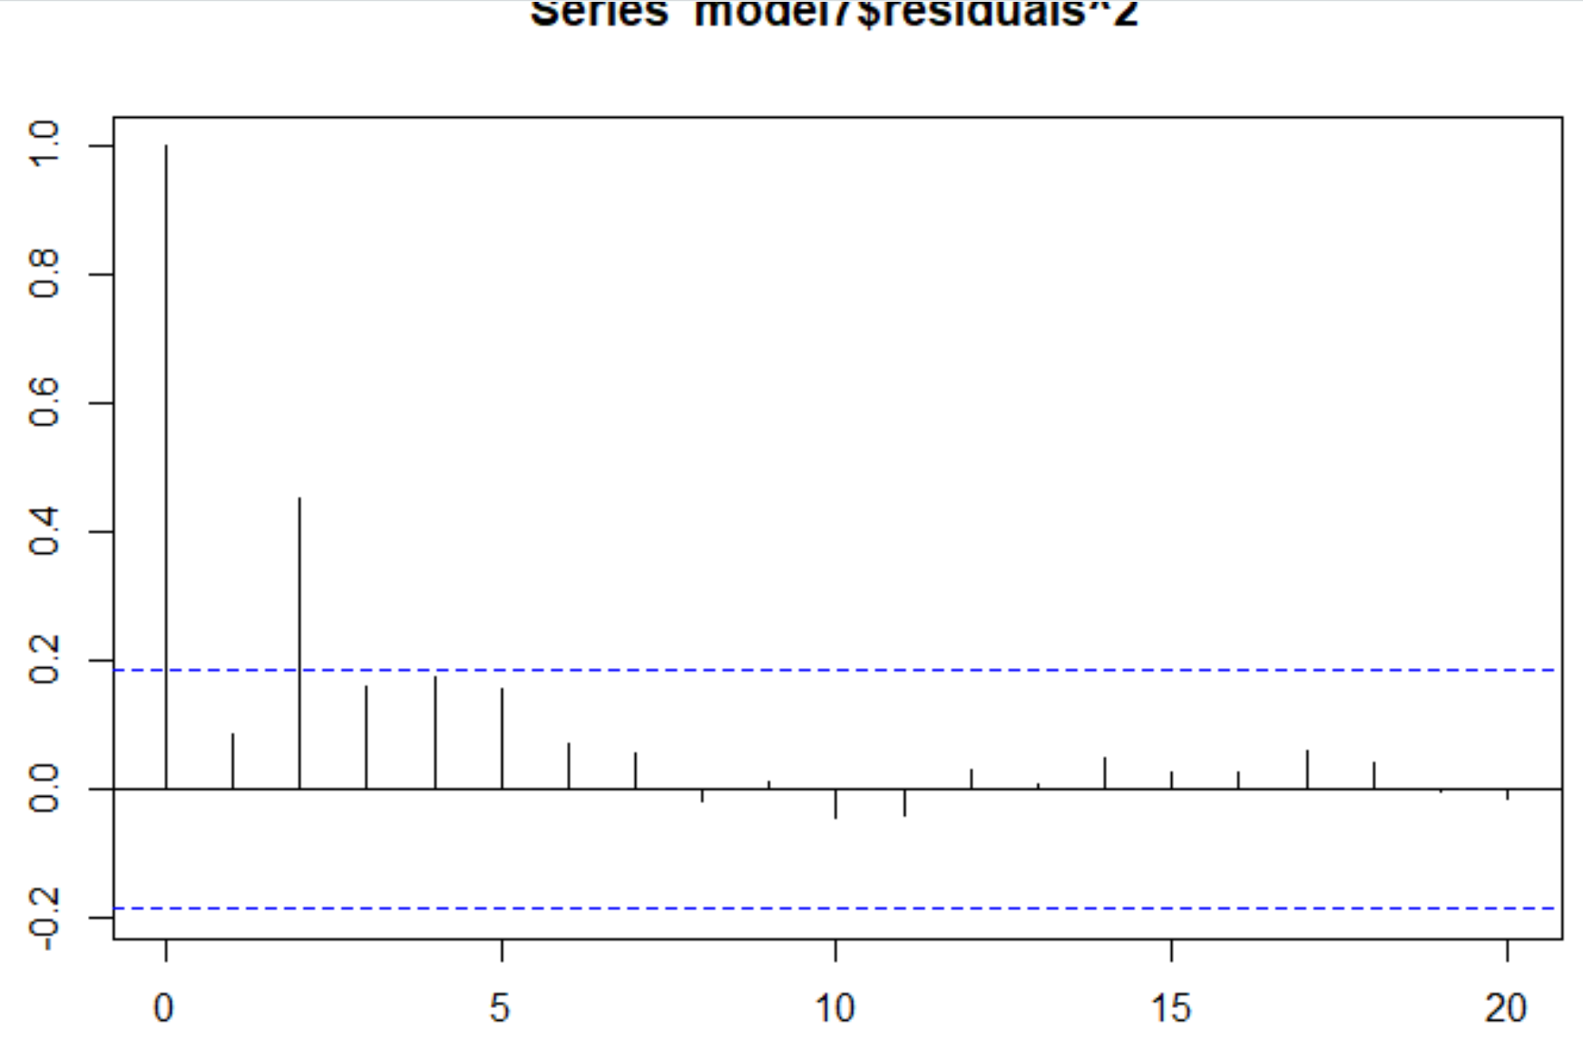
Time Series Plot of the Residuals^2

Slide 17
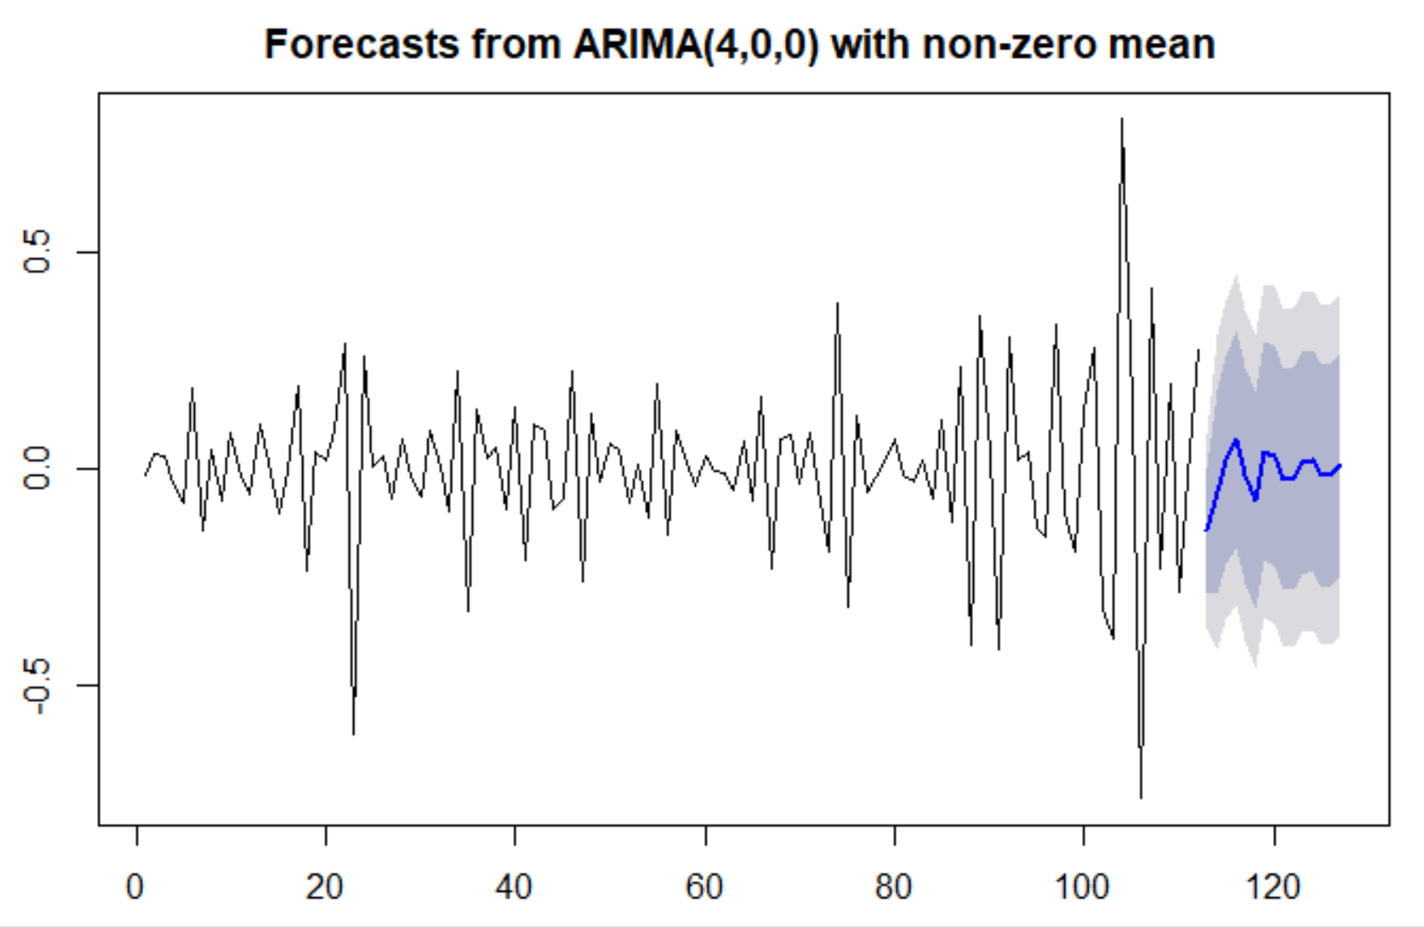
Prediction

Slide 18
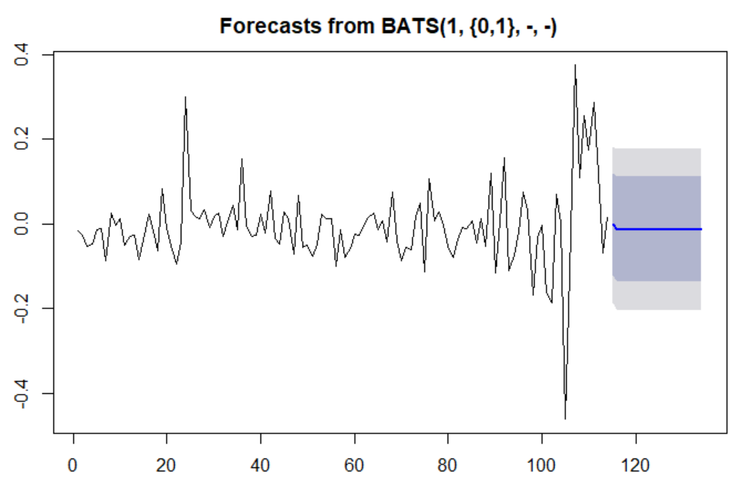
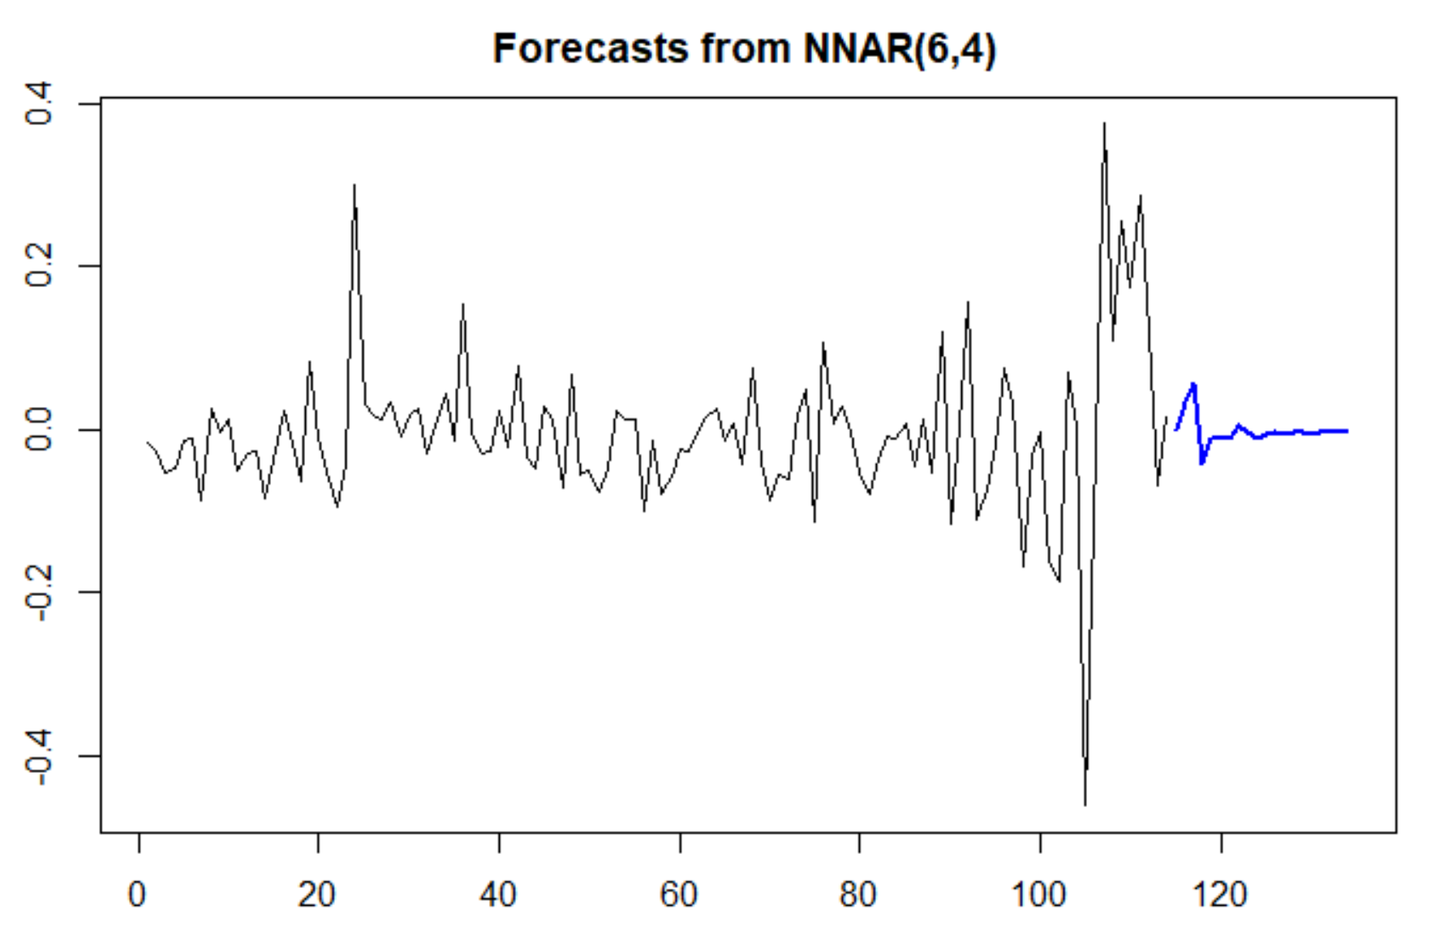
Other Types of Predictions

Slide 19
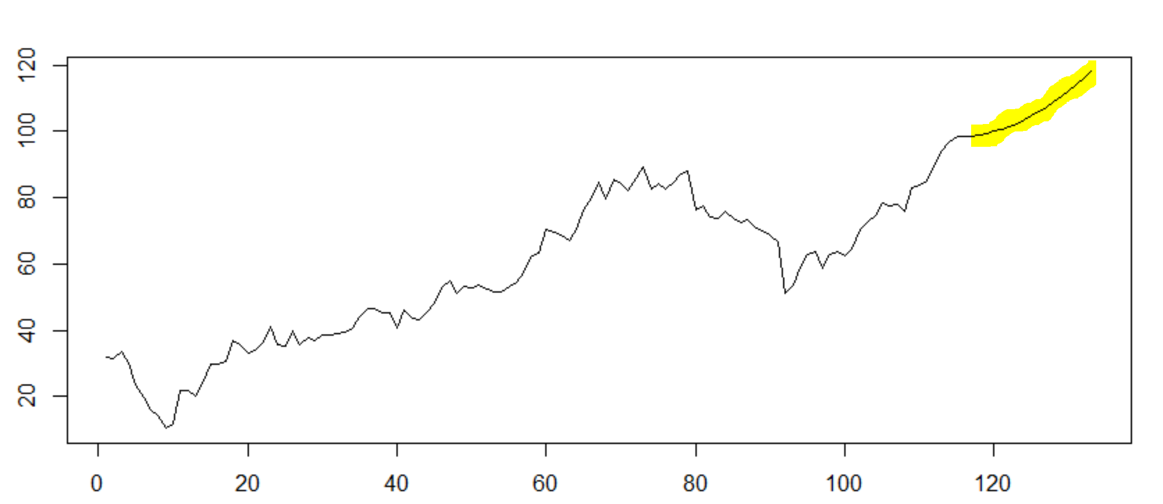
Predicted values are highlighted in the below plot.

Slide 20
Thank You

